Slide 1














YOUTUBE SONG ANALYSIS
using PowerBI
ANKIT KUMAR

Slide 2
This internship project aims to conduct a comprehensive analysis of YouTube songs data using PowerBI.
01.
OVERVIEW
The goal is to utilize PowerBI to create insightful visualizations and reports that provide a deeper understanding of YouTube songs performance, popularity, and user engagement.
02.
The analysis aims to uncover trends, preferences, and patterns in the data to aid content creators and stakeholders in optimizing their YouTube song content
03.

Slide 3
DATA
DESCRIPTION
1. video_id: Unique identifier for each YouTube video.
2. channelTitle: Title of the YouTube channel publishing the song.
3. title: Title of the YouTube song video.
4. description: Description provided for the YouTube song video.
5. tags: Tags associated with the YouTube song video.
6. publishedAt: Date and time when the YouTube song video was published.
7. viewCount: Number of views received by the YouTube song video.
8. likeCount: Number of likes received by the YouTube song video.
9. favoriteCount: Number of times the YouTube song video has been marked as a favorite.
10. commentCount: Number of comments posted on the YouTube song video.
11. duration: Duration of the YouTube song video.
12. definition: Video definition or quality (e.g., HD, SD).
13. caption: Availability of captions for the YouTube song video.

Slide 4
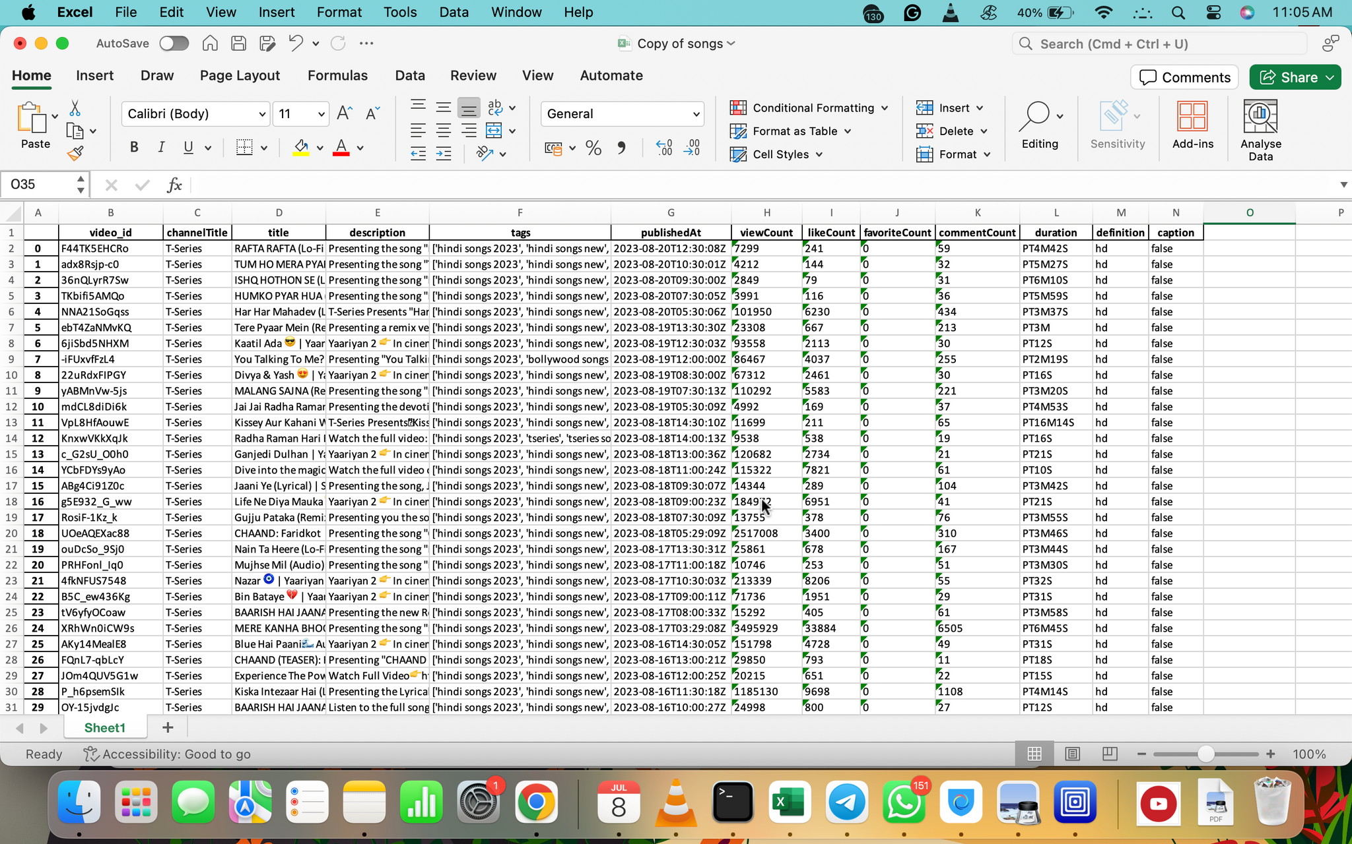

OVERVIEW OF DATASET

Slide 5

1. Data Cleaning and Preparation:
- Clean and preprocess the dataset, handling missing values or outliers.
- Convert relevant columns to appropriate data types.
3. Content and Channel Analysis:
- Analyze the distribution of videos across different channels.
- Identify popular tags and their correlation with view counts.
PROJECT
OBJECTIVE
4. Temporal Trends:
- Explore how YouTube song video metrics vary over time.
- Identify peak publishing times and their impact on engagement.
2. Exploratory Data Analysis (EDA):
- Explore patterns and distributions in view counts, like counts, and comments.
- Identify trends in the popularity and engagement of YouTube song videos.
5. User Engagement Insights:
- Investigate relationships between likes, comments, and views.
- Identify factors influencing user engagement with YouTube song videos.

Slide 6

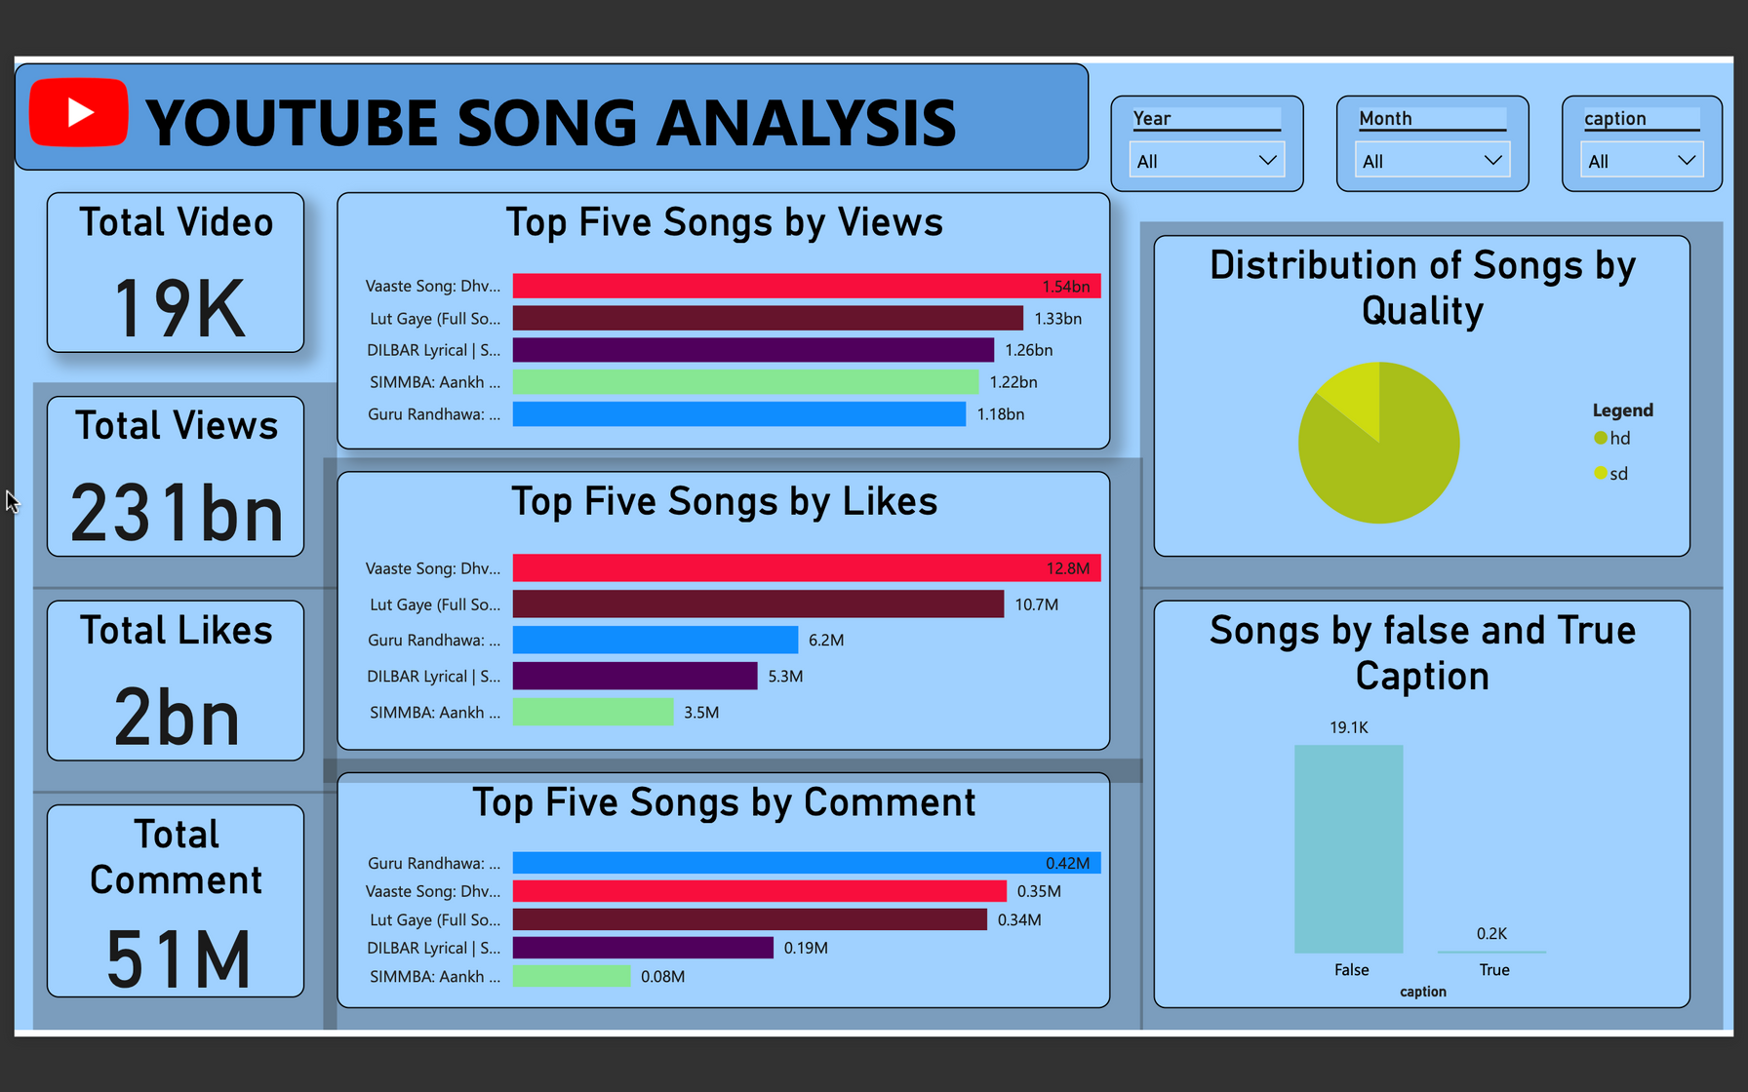

DASHBORD-1

Slide 7
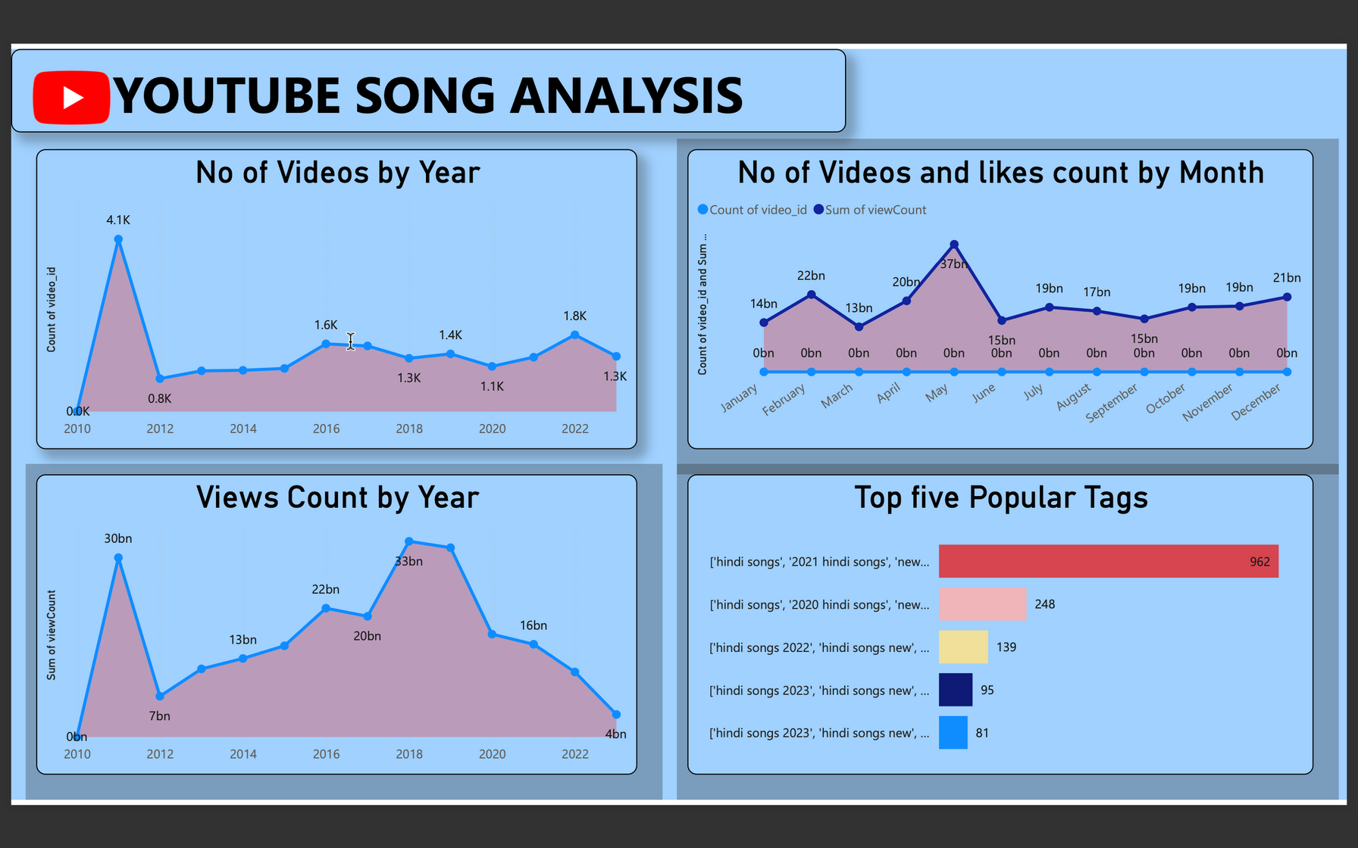
DASHBORD-2

Slide 8
INSIGHTS
Optimize titles & descriptions with keywords.
Engage viewers through comments and discussions.
Use relevant tags for search visibility.
Promote videos on social media.
Maintain a consistent posting schedule.
Create appealing thumbnails.
Collaborate with other creators.
Encourage subscriptions for updates

Slide 9
Thank you very much!

